Slide 1
Electrostatics Unit 5E Lesson Planning and Measuring Student Learning

Slide 2
Initial Ideas
Assess prior knowledge and preconceptions
Introduce a number of engaging electrostatic phenomena
Build a model of understanding mainly from student observations and provide a historical context and evidence
Focus on content relevant to explaining and understanding the phenomenon
(excludes Induction, 2D problems, Electric Potential*, ect.)
A Challenging Summative Assessment

Slide 3
Modeling an FCI Pretest
The Force Concept Inventory (FCI) instrument is designed to assess student understanding of the most basic concepts in Newtonian physics
Each question offers only one correct Newtonian solution, with common-sense distractors (incorrect possible answers) that are based upon student's misconceptions about that topic, gained from interviews.

Slide 4
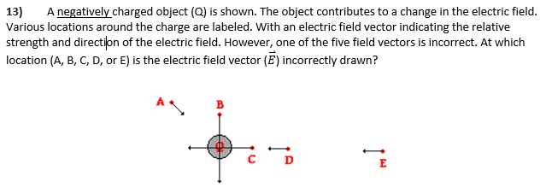
Example PreTest Questions
-Do not require computations
-Attempt to dig out misconceptions indicated by research
-Purposely difficult to see a variety in answers

Slide 5
Pretest Results
Very few predicted that uncharged objects were attracted to charged objects
Very few could use a quantum model of electrostatic to explain phenomena
Very
However about 50% new that magnitude of electron and proton charges were the same.
The first and second period classes averaged 26.7% and 26% respectively. This is in line with FCI scores which show percentages minimally above those expected by guessing (20%).

Slide 6
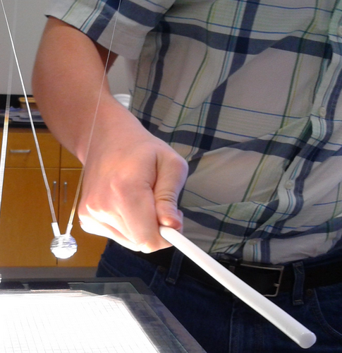
5E Model - Sample
Engage: Introduce two “Pith balls” (one just Styrofoam, one aluminum wrapped) Show attraction. Transfer charge show repulsion.
Pick up pieces of paper and aluminum foil. Write down observations on board.

Slide 7
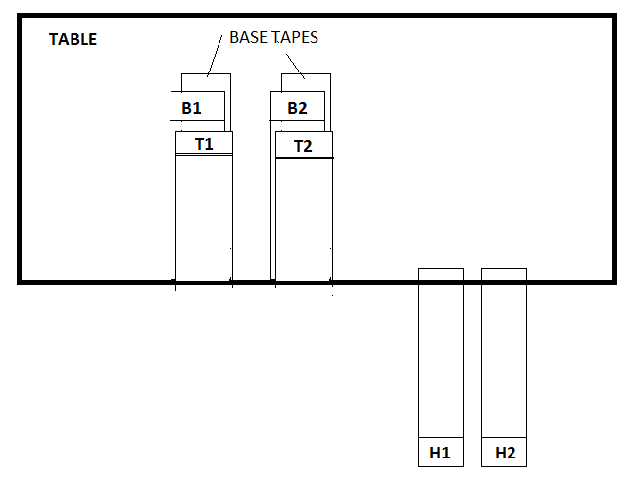
Explore: Observations with tape

Slide 8
Explain: Breaking down the tape lab
Introduce the idea that the definition of “negatively charged” is a rubber rod rubbed with fur. And everything else is derived from that definition.
Ask students to derive the charges of top and bottom tapes from this definition.
Define “charged” as either positive or negative and “uncharged” as neutral
Have students recognize that charged objects attract uncharged objects, but weaker, and by extension repulsion is the definitive test of charge.
Whenever positive charge appears negative charge appears on the other object, demonstrated with pith balls. (Separation of Charge)
 | BOTTOM 2 | TOP 2 | HANGING 2 | − ROD
BOTTOM 1 | REPEL | ATTRACT | ATTRACT | *REPEL
TOP 1 | ATTRACT | REPEL | ATTRACT | ATTRACT
HANGING 1 | ATTRACT | ATTRACT | NOTHING | ATTRACT

Slide 9
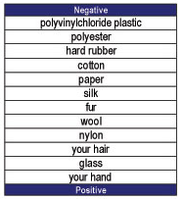
Elaborate: Triboelectric Scale.
Make predictions based on the triboelectric scale
Considered making this a lab, but it was difficult to charge several objects, but did not feel it warranted the time.
Most students appeared the understand from a demonstration that this scale is a consequence of experiments

Slide 10
Evaluate: Lab Analysis and Conclusion
Students were asked questions at the conclusion of the lab, which was submitted for a small grade.
Sample questions:
“It is not logically impossible to have a third type of charge outside of our definition of positive and negative. However, this has never been experimentally observed. Let’s suppose that by rubbing the rod with a very special type of material gives it this never before observed third type of charge. What would you have to do to prove to others that you have discovered a new type of charge? How would the TOP, BOTTOM, and HANGING pieces of tape react?“
Students were also asked to compare and contrast the electrostatic force with the gravitational force? *no student mentioned action at a distance without queuing.

Slide 11
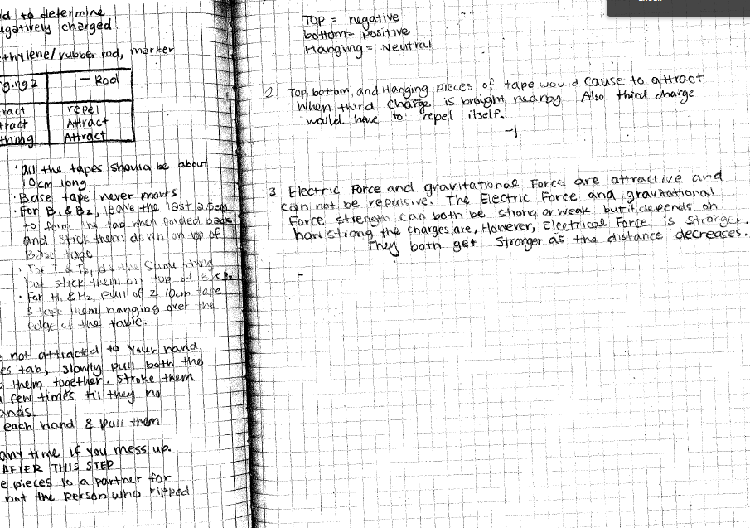

Slide 12
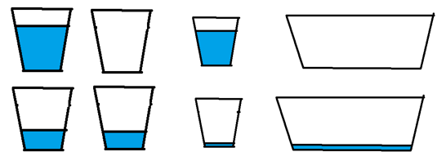
Conductors, Insulators, Grounding
Van de Graaff generator, touched with metal rod and a wooden ruler, spark trick,
Asked to think about a charged conducting sphere touching a neutral insulating sphere, a neutral conducting sphere of the same size, and a neutral conducting sphere of a bigger or smaller size.
Focused on the idea that the ground does not need to be the actual “ground”
Wanted to show the movement of charge rather than the “destruction” of charge that many students associate with “grounding.”

Slide 13
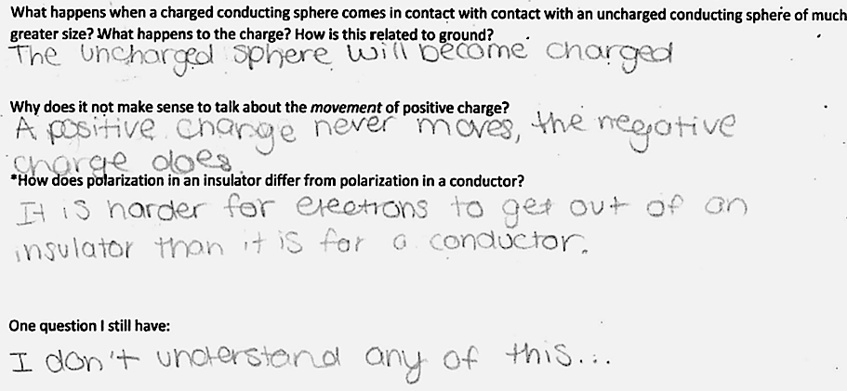
A lot of difficulty with Polarization
Introduced the quantization of charge and polarization as evidence for it at the same time, created a huge amount of confusion. Did not provide any tangible connection.
Most students recognized that electrons moved an protons did not.
Based on the exit slips chose to not move onto the lab immediately

Slide 14
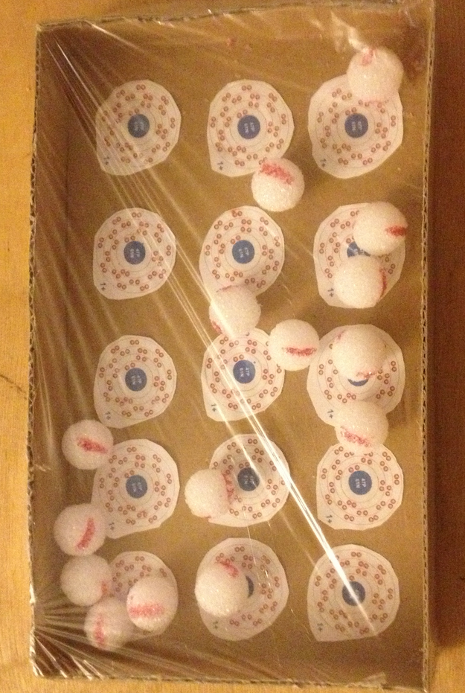
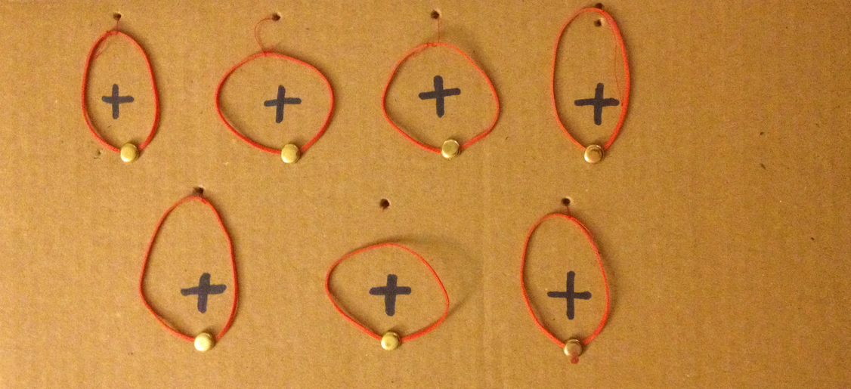
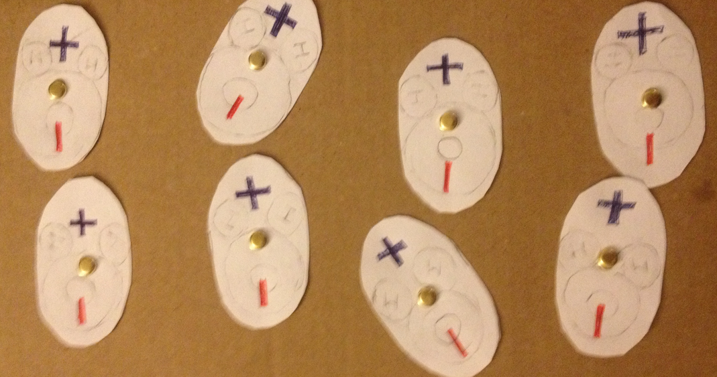
Spent an extra day with guided notes and questions that were turned in for a classwork grade.
Polarization: Insulators
Polarization: Conductors
Free moving Valence Electrons
Induced Dipole
Permanent Dipole

Slide 17
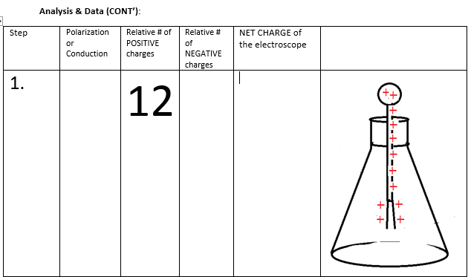
Polarization/Conduction Lab with Electroscopes

Slide 18
Introducing Coulomb’s Law
Practice drawing force vectors
Essentially everyone drew unequal force vectors, many did not know what I meant by drawing them
Many did not understand you could have a decreasing acceleration and an increasing velocity

Slide 19
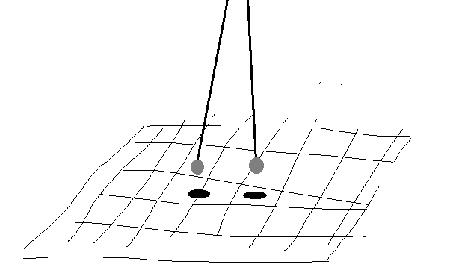
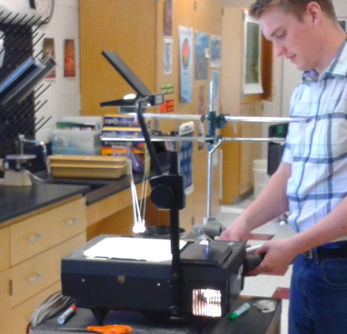
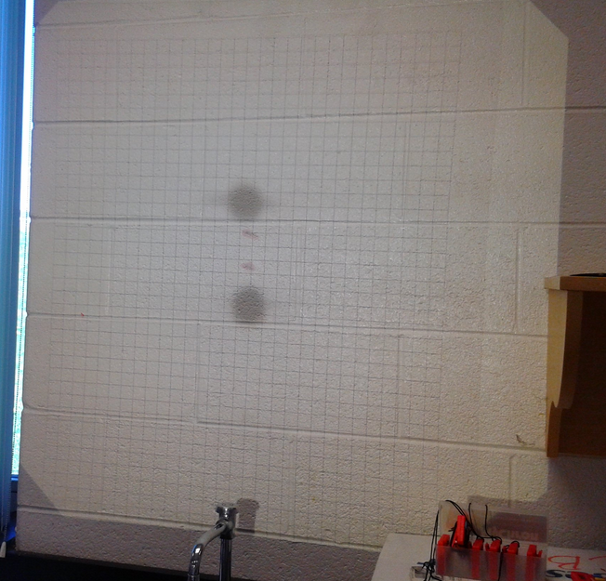
Exploring Newton’s Third Law

Slide 20
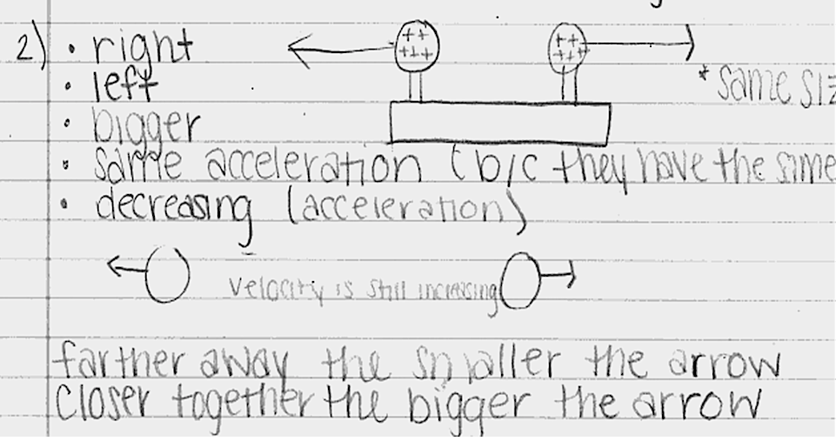
At this point I should have introduced a “positive x-direction”
Evaluating a Qualitative Understanding

Slide 21
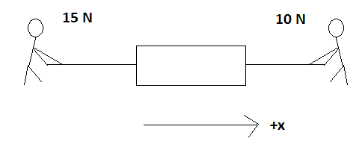
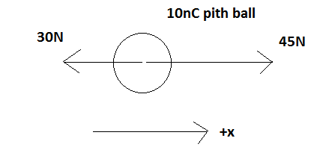
Coulombs Law and Superpostion
Difficultly with converting nC to C. (A lack of understanding what a constant is/does)
I used to explain mathematically polarization. In the future I will likely avoid the subject until Electric Fields.
Coulombs Law is only necessary to explain the force felt by a test charge and to make comparisons to the gravitational force.

Slide 22
Engaging with Action at a Distance
'That gravity should be so innate, inherent, and essential to matter, so that one body may act upon another at a distance through a vacuum and without the mediation of anything else, by and through which this action and force may be conveyed from one to another, is to me so great an absurdity, that I believe no man who has in philosophical matters a competent faculty of thinking, can ever fall into it. Gravity must be caused by an agent acting constantly according to certain laws; but whether this agent be material or immaterial, I have left to the consideration of my readers.' – Isaac Newton
How would you measure the strength of gravity anywhere in the Universe using a spring scale that measures force in Newtons and a mass that is known to be 0.5kg
$Strength of Gravity at a location=\frac{Reading of on the spring scale}{mass of the test object}$

Slide 23
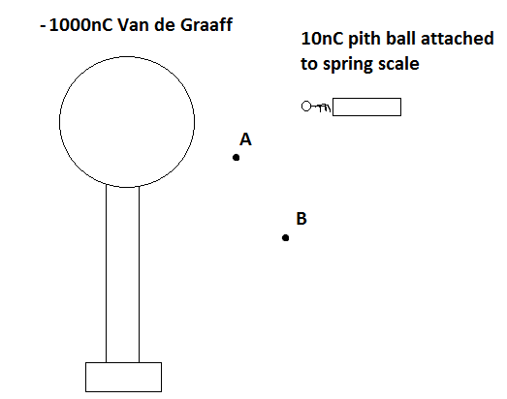
Introducing Electric Field as a Definition
$$E_{at a location}=\frac{F_{on at test charged object}}{Q_{magnitude of the positive test charge}}$$
Difficulty with it always being a positive test charge
Difficulty with locations vs. charges. Many thought that A and B were objects.

Slide 24
Student Generated Test Questions
 | 0 | 1 | 2 | 3 | points
True/False Question | No effort shown, Incorrect answer, no creativity | Little effort shown, little creativity, Requires little understanding of the material | Moderate effort shown, creativity shown, requires a firm understanding of material | Test Question used = creative, tackles a misconception, requires advanced understanding of material to answer question
Multiple Choice Question | No effort shown, Incorrect answer, not at least 4 choices, no creativity | Little effort shown, little creativity, Requires little understanding of the material to answer question | Moderate creativity shown, at least one wrong choice is focused on a misconception, requires a firm understanding of material to answer question | Test Question used = creative, more than one wrong choice is focused on a misconception, requires advanced understanding of material to answer question | X2
Quantitative Question | No effort shown, Incorrect answer, no creativity | Little effort shown, little creativity, requires only plugging numbers into a formula to solve | Moderate creativity shown, requires the manipulation of given formula, requires a firm understanding of material to answer question | Test Question used = very creative, tackles misconception, requires the manipulation of given formula, requires advanced understanding of material | X2
 |  |  |  | Total | _____/10 (possibility of 15 points)

Slide 25
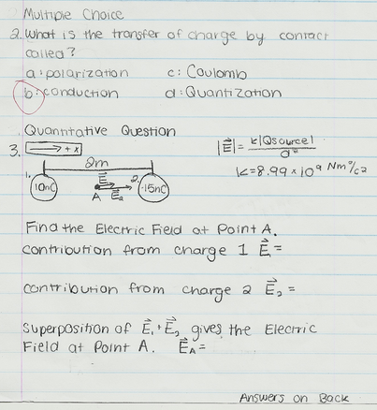
Our “I don’t understand any of this”
Many were examples from class, but with numbers changed. Many who did this failed to get similar questions correct on the summative test
Several revealed their own misconceptions or lack of clarity in their writing
Several were very creative and showed an understanding of misconceptions

Slide 26
Summative Test
11 T/F, 7 MC, 19 short Quantitative (Step-by-Step), 5 fill in the blank, 1 short essay. Together out of 50 points.
The average percentile scores for 2nd and 3rd period were 85.7% and 84.4& respectively

Slide 28
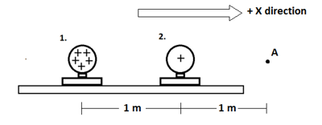

Slide 29
Summative Test Survey
7.5
6.7
6.1
5.1
Strong correlation between self reported understanding and raw score (25% of the variance),
very little correlation between self reported preparation and raw score
Confidence is Key?

Slide 30
Post test results
Most gains seen in explaining charge phenomenon
Much less significant gains in understanding diagrams
Post test scores were 52% and 56% for the two periods
FCI typically measures Gain:
Average individual gain by this definition was 0.325
FCI gains are around 0.23 for traditional teaching styles and from 0.34 to 0.62 for alternative teaching styles.
$$G=\frac{postest\% −pretest\%}{100\% −pretest\%}$$

